Slide 1


Changes in Tax Audit
CA. Pankaj G. Shah
BBA, LLB(Hons.), ACS, FCA, DISA(ICA)

Slide 2


Slide 3
To start with
Cross check things – Notes to accounts/CARO
Comparative analysis
Check capital account for major credits/exceptional
Read Guidance note
Documentation must
Tax Audit Review

Slide 4
Implications of Reporting
Section 143(1)
Disallowance indicated in audit report but not taken in computation of total income
Views taken disclosures
amended by FA 2016 wef AY 2017-18
S.143(1) intimation appealable

Slide 5
Changes from 20.08.2018
41 Clauses
6 amendments
9 insertions
Effective 50 CLAUSES
Reports submitted in old format till 19.08.2018 are Valid

Slide 6
Basic Changes
Clause 4: Goods and Services Tax registration number (GSTIN) to be mentioned
Clause 19: Investment Allowance under section 32AD of the Act to be reported
Section 32AD provides allowance @ 15% of the cost of any new assets acquired and installed in an undertaking for manufacture of any article after 1st April 2015 and before 1st April, 2020 in any notified backward area

Slide 7
Changes
Clause 24: Deemed gains under section 32AD of the Act to be reported
Deemed gains arising out of sale of asset on which allowance was claimed under section 32AD will have to be reported. If asset acquired as per the provisions is sold within 5 years from the date of installation, then the deduction shall be deemed to be the income
Clause 26: Sum payable to Indian railways for use of assets to be reported
any sum payable by the assessee to the Indian Railways for the use of railway assets can be claimed only on payment
Not services like freight, etc

Slide 8
Only expenses on Use of Railway assets
Rental for properties, ATM, hoardings, etc.
Not railway services
Passenger fare, etc are for availing services

Slide 9
Clause 29A: Advance received on capital asset forfeited to be reported
S.56(2)(ix)
  if any sum of money is received as an advance or otherwise in the course of negotiations for transfer of a capital asset and if such sum is forfeited or the negotiations do not result in transfer of such capital asset, then the same would be taxable as income from other sources
Under the new clause 29A, the tax auditor is required to report the nature of such income and the amount involved.
It would therefore be important for the auditor to obtain balance confirmations from third parties against whose names advances for capital assets are shown in the assessee’s balance sheet.

Slide 10
Forfeiture on breach of terms
Accounted
To be reported
No entry in books
Cannot be reported
Contracting party will always confirm the outstanding irrespective of terms
Verify agreement to verify contractual forfeiture accrual unless amendment
Ageing of all creditors and take Management representation on nature of liab

Slide 11
Clause 29B: Income of taxable gifts exceeding Rs. 50,000 to be reported
Section 56(2)(x), any person receiving any gift exceeding Rs 50,000 except from relatives and in some cases
The new clause 29B requires the nature of income and the amount involved to be reported.
Shares received at value < Rule 11UA
Personal gifts in case of individual?

Slide 12
Immovable property
Only on Land or building
Not applicable on Rights in land or building
Leasehold rights – CIT vs. Greenfield Hotels and
Estates P Ltd [2016] 389 ITR 68 (Bombay)
Tenancy rights – Fleurette Marine Novelle Hatam vs. ITO [2015] 70 SOT 203 (Mumbai - Trib.)
FSI and TDR – ITO vs. Shri Prem Rattan Gupta
(ITA No.5803/Mum/2009)

Slide 13
Transfer of Shares of Co. with Land
Book value of shares is Rs. 100 considering Historical cost of land being Rs. 1,00,000
Market Value of Land being Rs. 1,00,00,000
Whether transfer of shares at Rs. 100 per share to be reported?
Irfan Abdul Kadar v. ACIT 56 SOT 12 (Mum)
Section 50CA r.w. Rule 11UA

Slide 14
Movable properties
Unquoted share Rule 11UA
Market value of immovable properties
+ Book value of other assets
- Book value of Liabilities
+ Market value of investments in securities

Slide 15
Clause 30A: “Primary Adjustments” in transfer pricing as per Section 92CE
If TP report in Form 3CEB suggests any adjustments, details to be given :
Clause of 92CE(1) -
Amount of primary adjustment.
Whether the excess money available with the AE is required to be repatriated as per 92CE(2)
If yes, whether the excess money has been repatriated within the prescribed time.
If no, the amount of imputed interest income on such excess money which has not been repatriated within the prescribed time.
Repatriable up to 30th December
Section 143(1)(a)

Slide 16
Thin Capitalization
Clause 30B: Limitation of interest deductions for borrowings from an Associated Enterprise up to 30% of EBITDA is to be furnished
As per Section 94B(1) of the Act, if an Indian Company or a Permanent establishment of a foreign company in India
interest or of similar nature exceeding one crore rupees which is deductible
in respect of any debt issued by a non-resident, being an associated enterprise of such borrower,
the interest shall not be deductible > 30% of EBITDA.
Interest rates arbitrage

Slide 17
Clause 30C : GAAR - Deferred
Details of Impermissible Avoidance Arrangement to be furnished as referred to in Section 96
Nature of the impermissible avoidance arrangement.
Amount of tax benefit in the previous year arising, in aggregate, to all the parties to the arrangement.

Slide 18
GAAR
Subjective – no definite criteria like SAAR
Tax planning vs. Tax Avoidance
Sham
No commercial motive
AO and CIT cannot decide
Approving panel
Transaction >Rs. 3 crore
Section 143(1)(a)

Slide 19
Clause 31: Cash receipts >=Rs. 2,00,000 (Section 269ST)
an assessee is not allowed to receive an amount of Rs. 2,00,000 and above in aggregate from
any person in a day or
in respect of a single transaction or
in respect of transactions relating to one event or occasion from a person
otherwise than by a cheque or bank draft or use of ECS through a bank account.
After the existing sub clause (b) in clause 31, several new sub clauses have been inserted and these lay down the various details required to be disclosed:
Automatic Penalties

Slide 20
Clause 31 : 269ST
i. Name, address, Permanent Account Number of the payer,
ii. Nature of transaction
iii. Amount of receipt.
iv. Date of receipt.

Slide 21
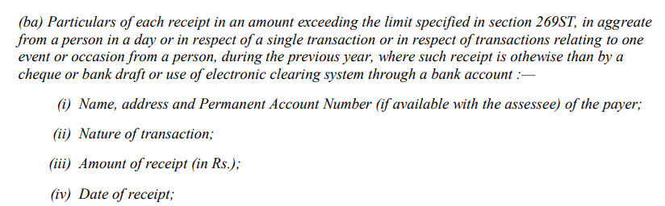
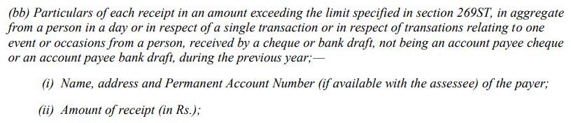
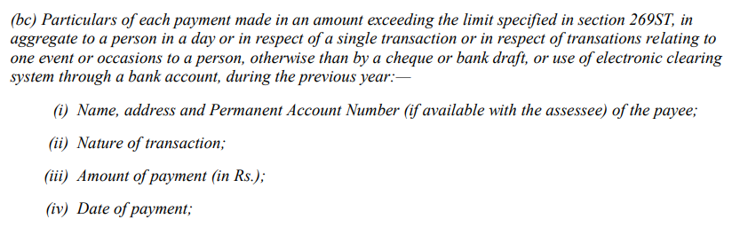

Slide 22
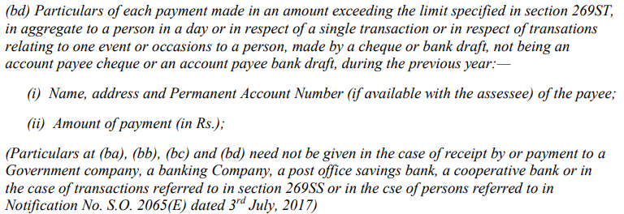

Slide 23
Clause 31
(a) deals with loans or deposit 269SS
(b) deals with specified sum
specified sum is money receivable as advance or otherwise in relation to transfer of an immovable property, whether or not transfer has taken place
What in case of real estate business?
(c) repayment of Loan, deposit or specified sum
Whether repayment through cheque, bank draft, ecs
If yes whether the same was even received through account payee cheque or bank draft?

Slide 24
Clause 31
(d) Repayment received otherwise than cheque, bank draft, etc.
  Name, address, PAN(If available)
  Amount
(e) Repayment received by cheque which is not account payee
  Name, address, PAN(If available)
  Amount

Slide 25
Clause 34: Details with respect to transactions not disclosed in TDS Return/ TCS Return
a) TAN
b) Type of Form.
c) Due date for furnishing
d) Date of furnishing, if furnished
e) Whether the statement of tax deducted or collected contains information about all details/transactions which are required to be reported. If not, furnish list of details/transactions which are not reported.
Transactions where no deduction to avoid 234E and prosecution

Slide 26
Clause 36A: Dividend received under Section 2(22)(e) required to be reported
If any
Jurisprudence
such dividend is
received
then the amount of dividend and the date of receipt need to be disclosed in the Form now.
Bhaumik Colour SC

Slide 27
Company
Relative of Shareholder
Shareholder
Loan of Rs.1,00,000 out of accumulated profits
Deemed Dividend
Received
No audit trail
If disclose here then 143(1)

Slide 28
Clause 36A: Dividend received under Section 2(22)(e) required to be reported
From AY 2019-20
Next year another amendment expected
Taxable in hands of company not recipient

Slide 29
Clause 42: Details with respect to Form 61, Form No. 61A and Form No. 61B
Form 61 (Statement containing particulars of declaration received in Form No. 60)(No PAN)
Form 61A (Statement of Specified Financial transactions)
Form 61B (Statement of Reportable Account under sub-section (1) section 285BA of the Act)
if submitted, are to be disclosed:
  i. Income-tax Department Reporting Entity Identification No.
  ii. Type of Form.
  iii. Due date for furnishing.
  iv. Date of furnishing, if furnished.
  v. Whether the Form contains information about all details/transactions which are required to be reported. If not, furnish list of the details/transactions which are not reported.

Slide 30
Clause 43: Country-by-Country Reporting as referred to in Section 286
Any company liable to reporting under sub-section (2) of section 286 of the Act, needs to disclose the following information in Form 3CD
  i. Whether report has been furnished by the assessee or its parent entity or an alternate reporting entity?
  ii. Name of parent entity.
  iii. Name of alternate reporting entity (if applicable).
  iv. Date of furnishing of report.
The auditor would need to go through the CbCR and then report under this clause.
MLI

Slide 31
Clause 44: GST related - Deferred
Data analytics
Matching the data available with the various tax wings of the Finance Ministry.
tracking and punishing tax evaders
Software / Manual working required

Slide 32
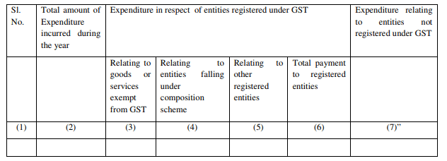
Even expenditure made in pre-GST period to be given based on subsequent registration

Slide 33
Total Expenditure
Registered supplier GST
Exempt goods and services
Supplier in Composition
All others
Total payment
Unregistered suppliers
ITC
Block Cr

Slide 34
Things to do first
Master updation
GST No. of inward supplier
Specify Composition or Regular
Tax Classification of goods
Exempt
Taxable
Tally software is working on it

Slide 35
Total Expenditure incurred during the year
Total expenditure as per P&L
Capital expenditure?
Depreciation?
“Expenditure” “incurred”

Slide 36
3.Expenditure relating to Registered entities Relating to goods and services exempt from GST
Exempt (Section 2(42))
Exempt – Bread, fresh fruits, milk
Nil Rate – Grain, Salt, Jaggery
Non GST – Petrol, Diesel

Slide 37
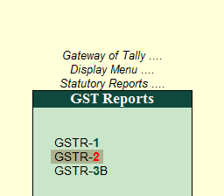

Slide 38
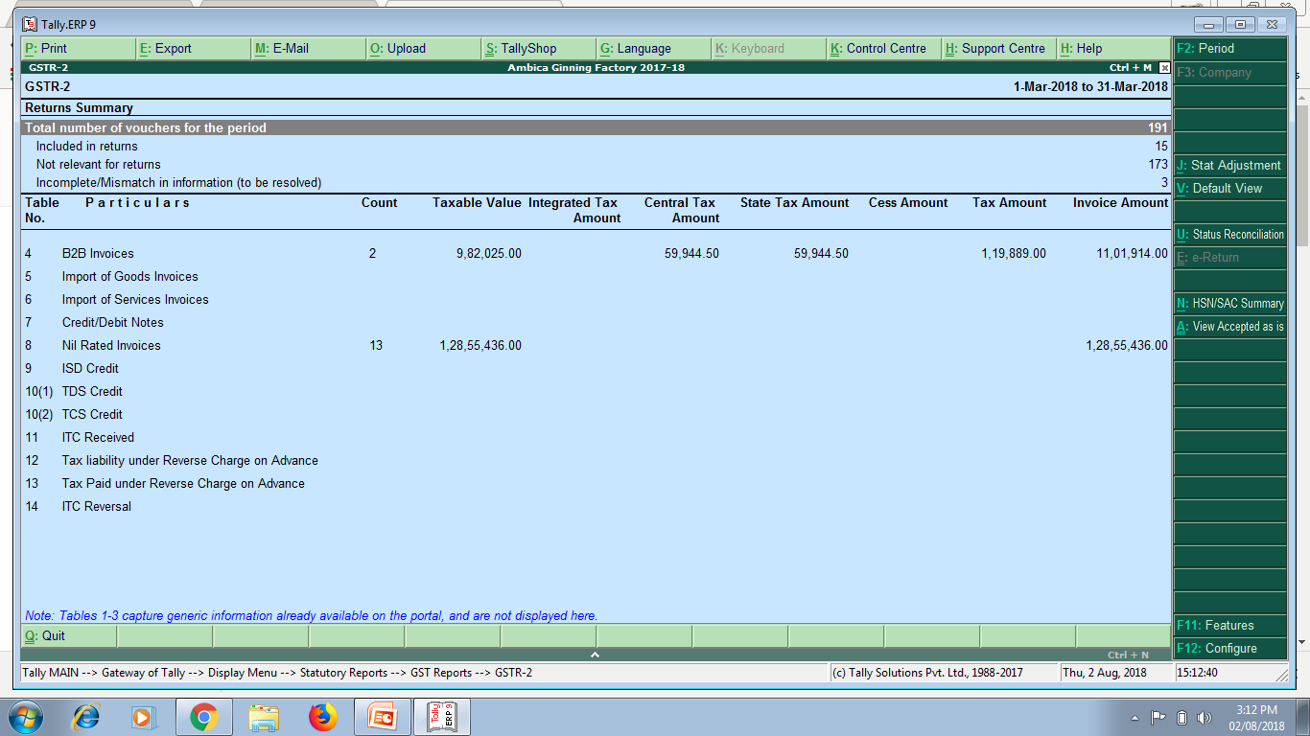
GSTR-2 – Inward supplies
NIL RATED INVOICES

Slide 39
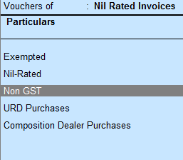

Slide 40
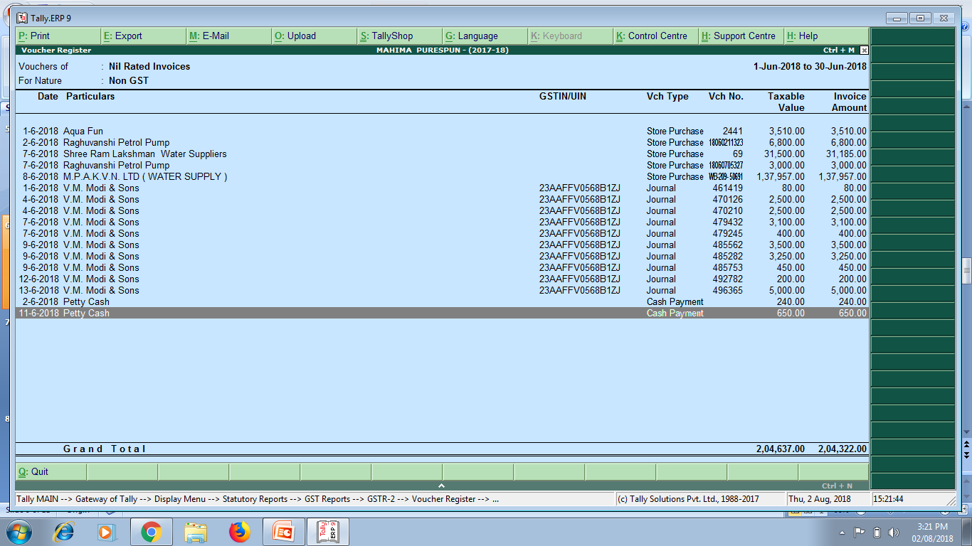
Export these into Excel and add them

Slide 41
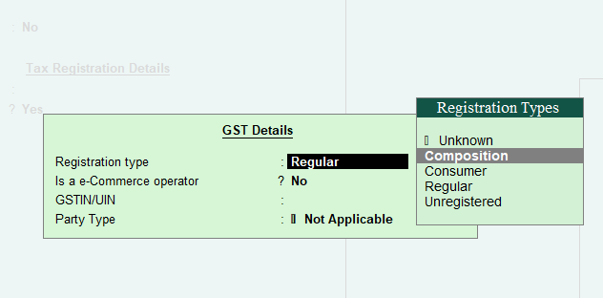
Expenditure relating to Registered entities – Composition Scheme
Relating to entities falling under composition scheme
  Tally feature, While creation of Vendor Master

Slide 42
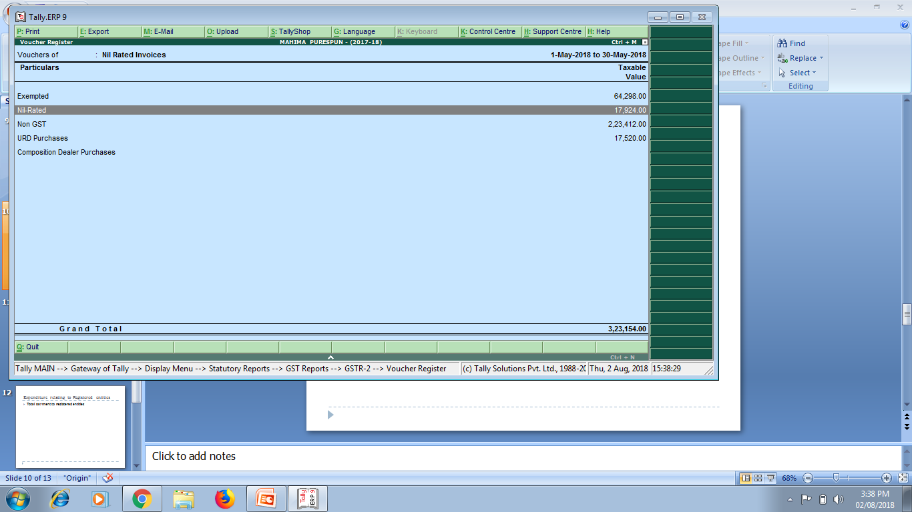
Composition dealer purchases

Slide 43
Expenditure relating to Other
Registered entities
ITC being claimed
Blocked credit
Capital assets?

Slide 44
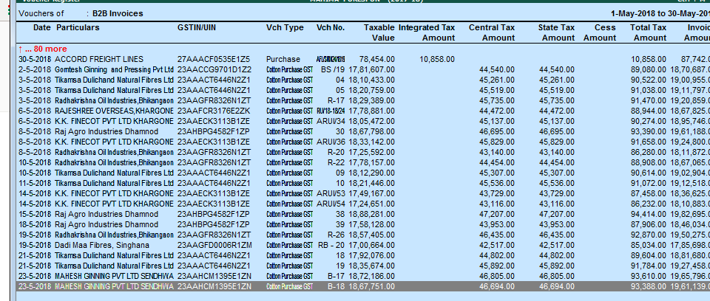
B2B Invoices in Form GSTR2
If GSTIN does not appear then update the master

Slide 45
6. Total Payment to Registered entities
Aggregate of
Exempt Inward supplies in Colum 3
Composition Inward supplies in Column 4
Other supplies in Column 5

Slide 46
Expenditure related to Unregistered entities
Total Expenditure (Column 2)
Less: Total payment to registered entities (Column 6)

Slide 47
Avinash Gupta vs. CIT 378 ITR 137 (Del)
Forms should be made available on 1st April
Discrimination before and after 20.08.18
Quality of audit incomplete before 20.08.18 may get compromised
ICAI Representation 02.08.18
defer it to AY 2019-20

Slide 48
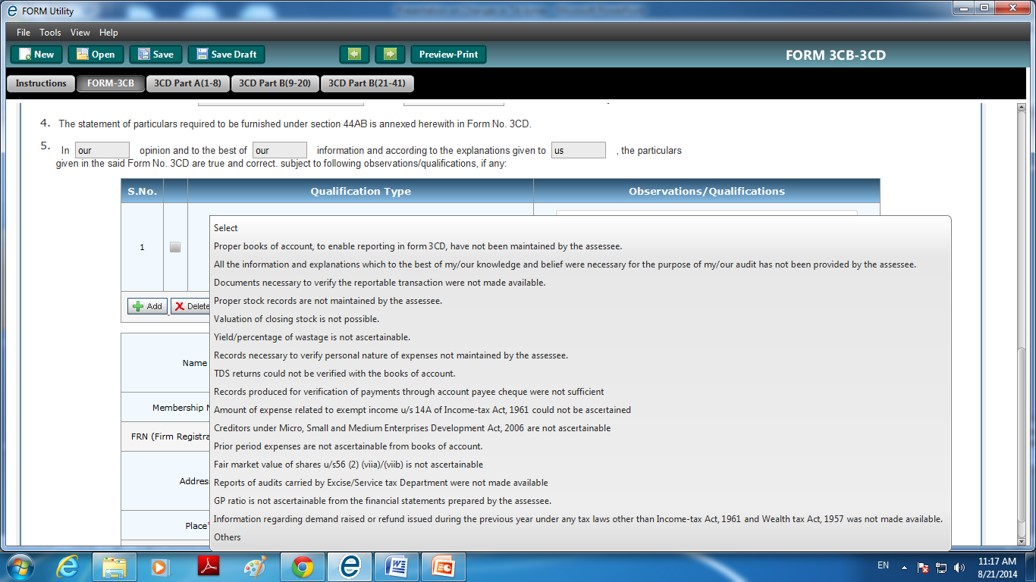
Manual Systems
IF such information not available, please give note
  Form 3CA
  Form 3CB – Clause 5

Slide 49
Suggestive Note in 3CA/3CB
Clause 44: We have been informed by the assessee that the information required under this clause has not been maintained by it in absence of any disclosure requirement thereof under the Goods and Service tax statute. Further the standard accounting software used by Assessee is not configured to generate any report in respect of such historical data in absence of any prevailing statutory requirement regarding the requisite information in this clause. In view of above we are unable to verify and report the desired information in this clause

Slide 50
Clause 18
Depreciation cap at 40%
Effect of section 40A(3)
Addition of assets purchase in cash > Rs.10,000
Difference in book

Slide 51
Old clauses

Slide 52
Clause 9 : Partnership
Verify Deed of Partnership for the names of the partners and their profit sharing ratios. Disclose change/s in the ratio. Ratio for sharing losses, if different from the profit sharing ratio, should be disclosed.
Check remuneration mentioned in Deed
Cross verify the names of the partners and their profit sharing ratios with that in the accounts of the current year and that of the previous year to ascertain any change.
[Firms includes Limited Liability Partnership (LLP) also]

Slide 53
Cl 11: Books of accounts
Location of Books of accounts
If books of accounts are kept are more than one location, then furnish the addresses of all the locations along with the details of the books of accounts maintained at all such locations.
Avoid address of residence

Slide 54
Cl 12 : Presumptive
Commission and brokerage not covered
If for any business tax audit is not done then disclose

Slide 55
Cl 13
Cash or Mercantile - Sub clause (a) to (c)
Verify Notes to Account for disclosure of significant accounting policies.
Compare with previous year’s tax audit report for basis adopted.
Scrutinize Notes to Accounts, Auditors’ report and CARO for change in method of accounting and the quantification thereof.
ICDS

Slide 56
Some Important icds

Slide 57
Mark to Market Concept
MTM/Expected losses will not be allowed
FAQ MTM profits also not to be taxed

Slide 58
TREATMENT
OF MTM
Allowable/Taxable
Monetary Items
Cash
Receivables
Payables
Not Allowable/Taxable
Non monetary items
Fixed Assets
Forex derivatives
Currency Futures

Slide 59
Mark to Market
Particulars | Enter rate | Year end rate 31.3.18 | MTM Gain/(Loss)
Foreign Currency Creditors | 50000$ @ Rs.60 =30,00,000 | 50000@ 65 =3250000 | (Rs.2,50,000)
USD Future June contract | 1 lot of 10000$ @ Rs.62 | 1 lot of 10000$ @ Rs.68 | (Rs.60000)
Foreign Currency Balance in NRO Account | 10000$ @ Rs.60 =6,00,000 | 10000@ 65 =6,50, 000 | Rs.50,000
UK Pound Future July contract | 2 lot of 5000 UKP @ Rs.80 | 2 lot of 5000 UKP @ Rs.85 | Rs.50,000
Allowable
Not
Allowable
Taxable
Not
Taxable

Slide 60
Change in an accounting policy
Material Impact
Disclose
Year of change
Year in which such change has first material impact
No Material Impact
No disclosure required

Slide 61
Inventory has been accepted as certified by the Management

Slide 62
Approach
Inventory list as on year end date
Shortage and Excess list on verification by Client
Obtain Purchase and Sales for April to June
Physical verification (SA)
Existence and condition of Inventory
Inventory is material item of Balance sheet

Slide 63
Trading Account
Expenses | Qty | Amount | Income | Qty | Amount
Op. Stock | 100 kg | 10000 | Sales | 600kg | 120000
Purchases | 1000kg | 100000
Profit
Closing Stock 500kg 50,000
600kg 60000
Purpose of Inventory valuation is to set off the cost of unsold value from purchase debited to ascertain correct profit
Inventory Valuation cannot result in profit

Slide 64
Other Issues (Revised)
Standard costing method of inventory valuation permitted if standard cost approximates actual cost
Weighted Average and FIFO accepted
LIFO not acceptable
Notes:
Recoverable taxes not to be reduced from cost. Same as 145A

Slide 65
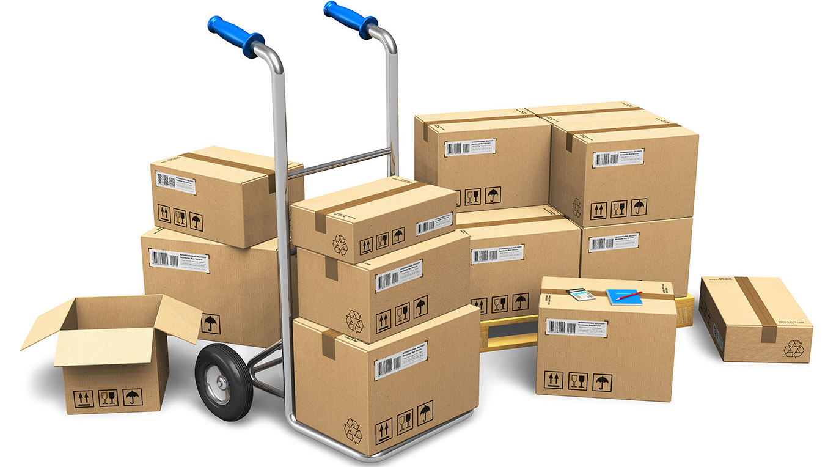
Cost Formulae – FIFO, WEIGHTED AVG.

Slide 66
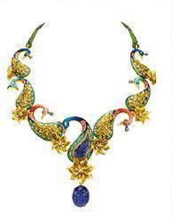



Specific Identification method

Slide 67
First-in First-out and Weighted Average Cost Formula
16. Cost of inventories, other than the inventory dealt with in paragraph 13……………..
PARA 13
“13. The Cost of inventories of items
(i) that are not ordinarily interchangeable; and
(ii) goods or services produced and segregated for specific projects shall be assigned by specific identification of their individual costs.
14. 'Specific identification of cost' means specific costs are attributed to identified items of inventory.”

Slide 68
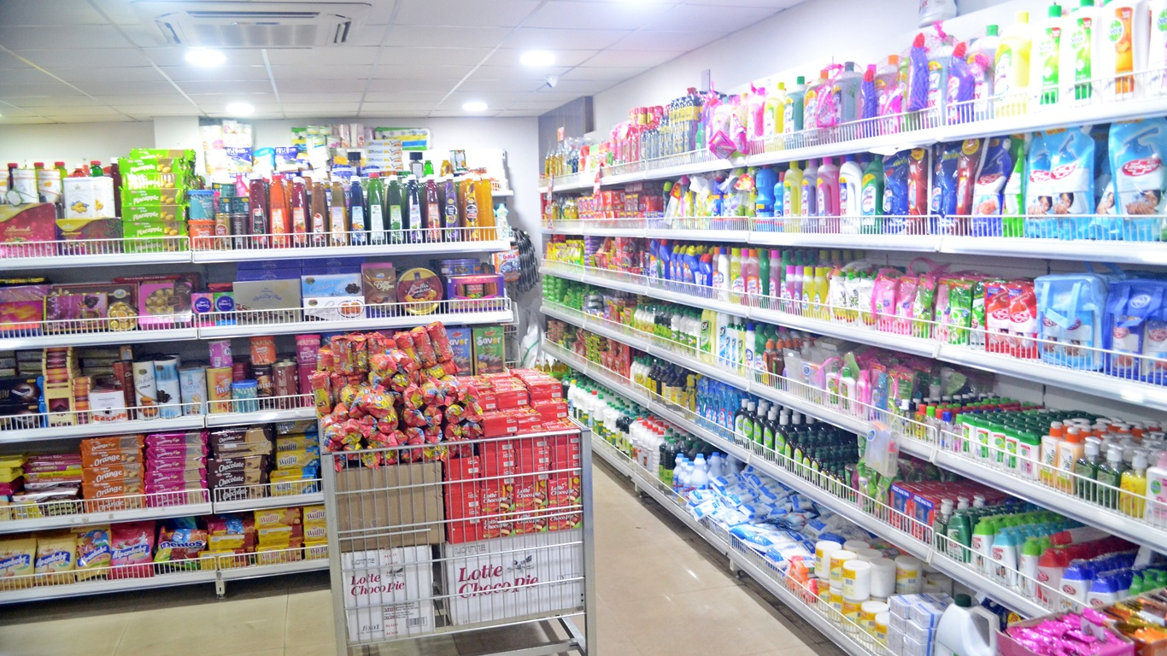
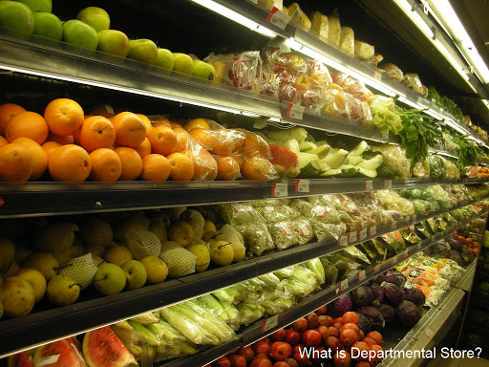
Retail Method

Slide 69
Retail Method
In respect of retail method of measuring inventory, cost is determined by reducing appropriate percentage of gross margin from the sales value.
ICDS now requires that an average percentage for each retail department under retail method is to be mandatorily used

Slide 70
WIP for Service Providers
AS
Excludes WIP of Service Providers
ICDS 
Definition of Inventory (all tangible)
(i) held for sale in the ordinary course of business;
(ii) in the process of production for such sale;
(iii) in the form of materials or supplies to be consumed in the production process or in the rendering of services.
Revenue Recognition
Percentage Completion method
The cost of services in case of a service provider shall consist of labour and other cost of personnel…………….
Short period Services taking <90 days

Slide 71
Disclosures
General Disclosure
Raw materials, work-in-progress, finished goods, goods for trade and stores, spares, etc. are valued at cost or net realisable value, whichever is lower.
Goods in transit are valued at cost to date.
‘Cost’ comprises all costs of purchase, costs of conversion and other costs incurred in bringing the inventory to the present location and condition.
The cost formulae used is either ‘first in first out’, or ‘specific identification’, or the ‘average cost’, as applicable.

Slide 72
Specific Disclosure
Carrying cost of inventory as on Balance Sheet date is as follows:
  Finished goods………..,
  Traded goods…………….,
  Work in progress………………,
  Raw materials……………

Slide 73
Securities
Deals with Securities as Stock in trade
Lower of Cost or NRV
Category wise Valuation

Slide 74
Shares | Cost | NRV | Notional Gain / Loss | Accounting Standard
Satyam | 1000 | 100 | (900) | 100
Infosys | 100 | 2000 | 1100 | 100
ICDS |  |  |  | 200

Slide 75
Service and Construction Contracts
Only Percentage Completion Method
Builders
After completion – goods
Before completion – construction service
Notes:
CIT vs. Triveni Engineering 49DTR 253 (Del),
CIT vs. Advance Construction 275 ITR 30 (Guj)),

Slide 76
Construction Contracts
Early stage of contract not beyond 25%
If during early stage of contract, the outcome of the contract cannot be estimated reliably, both AS and ICDS require that the contract revenue is recognised only to the extent of costs incurred.
Notes:
CIT v. P & C Constructions (P.) Ltd. [2009] 318 ITR 113 (Mad.)

Slide 77
Real Estate Developers
Department insists on Percentage completion method
CASS reason
Conditions
Significant risk and rewards are transferred
At 25% project activity is complete
10% advance of agreement value is received
whether percentage completion method followed?
25% area is secured (booking done)

Slide 78
Case 1
There are 10 plots in a project
10% Advance received in respect of 8
Revenue recognition for only 8 projects

Slide 79
Case 2
Total Saleable area = 20000 sq ft.
Estimated Project Cost = 600 Lakhs
(Land = 300 Construction = 300)
Cost incurred till date = 360 Lakhs
Land = 300 construction = 60)
Total area sold = 5000 sq ft.
Sale consideration agreed = 200 Lakhs
Amount realized till year end = 50 Lakhs
Notes:
No revenue recognition

Slide 80
25% area sold
More than 10% advance received on it
60% of total project cost incurred
25% of construction cost not incurred

Slide 81
Case 3
Total Saleable area = 20000 sq ft.
Estimated Project Cost = 600 Lakhs
(Land = 300 Construction = 300)
Cost incurred till date = 390 Lakhs
Land = 300 construction = 90)
Total area sold = 5000 sq ft.
Sale consideration agreed = 200 Lakhs
Amount realized till year end = 50 Lakhs
Notes:
No revenue recognition

Slide 82
Stage of completion
  Contract cost incurred / Estimated total contract cost
  390/600 = 65%
Sale agreement for consideration = 200 Lakhs
  65% of 200 Lakhs
Revenue to be recognized = 130 Lakhs
Prop.Contract cost = 5000/20000 * 390 Lakhs = 97.5 Lakhs
Contract Profit/Income = 32.5
Work in progress = 390 – 97.5 = 292.5

Slide 83
Government Grants
Grant Received
Depreciable Asset
Specific
Specific Reduction
Non Specific
Reduction from All assets
Non Depreciable
P&L

Slide 84
Cl. 15: Capital Asset converted into Stock in trade
Only evidence of such Conversion
JV / Ratio deal Agreement in Real estate results in ‘transfer’-
Chaturbhuj Dwarkadas 129 Taxman 497(Bom HC)
Convert into stock in trade first – Definition of ‘transfer’ not applicable on stock-in-trade
Useful in Assessment and Appellate Proceedings
Conversion to be reported in Clause 17 if below 50C value
Amendment in FA 17 applicable to Individuals and HUF

Slide 85
Clause 17: Cases u/s 50C and 43CA
“Where any land or building or both is transferred during the previous year for a consideration less than value adopted or assessed or assessable by any authority of a State Government referred to in section 43CA or 50C, please furnish:”
Details of Property | Consideration Received or Accrued | Value Adopted or Assessed or Assessable

Slide 86
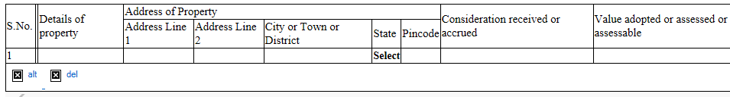
Clause 17: Audit Checklist
Check from 26AS statement on Income tax Portal for TDS u/s 194IA
Check Fixed Assets Account, Investment in Immovable assets account and other Ledgers
Obtain copy of Registered Deed duly certified by Auditee or Sale Agreement
Obtain a Management Representation of land and building sold and values.

Slide 87
Clause 17: Audit Checklist
Cross check value on global basis based on District Registrar Guidelines at website
Value Adopted/Assessed / Assessable to be obtained from Registered Valuer’s report where transfer not registered Eg. POA, JDA
Copy of Appeals/Orders before Stamp Authorities

Slide 88
Clause 17: Issue 1
Reporting of all cases of Transfer of Land or Building?
Details of Property | Consideration Received or Accrued | Value Adopted or Assessed or Assessable
Shop at Indore | 1,00,00,000 | 2,00,00,000
Building at Indore | 1,00,00,000 | 1,00,00,000
“….. consideration less than value adopted or assessed or assessable… please furnish”
G.J. Shah & Company
Chartered Accountants

Slide 89
Clause 17: Issue 2
Auction of mortgaged property by Bank
“Where any land or building or both is transferred….”
Reporting has to be done
Offer Actual consideration in Return
Give suitable note in 3CA/3CB

Slide 90
Cl. 18 - Depreciation
Maximum Rate of depreciation now
40%

Slide 91
Clause 18: Depreciation on Intangibles
Item | Citation
Goodwill | SMIFS SECURITIES Ltd. (Supreme Court)
Skill and Knowhow of Labour | BOSCH LTD v. CIT (2009-TIOL-736-ITAT-BANG)
Brand Name | Raveendran Pillai 332 ITR 549 (Kerala HC)
Non Compete | Medicorp Tech. 21 DTR 69
Marketing and Commercial Rights | Skyline Caterers (20 SOT 266)

Slide 92
Depreciation
Car Registered in Partner’s name – Reflected in Firm’s Balance Sheet – What about Depreciation
  CIT Vs. Aravali Finlease Ltd. 341 ITR 282 (Guj)
  Edwise Consultants P. Ltd. Vs. DCIT 44 ITR 236 /45 CCH 392 (Mum.Trib.)
Depreciation on Individual assets which are not used but forming part of block of asset
  CIT Vs. G. R. Shipping Ltd. – ITA No. 598 of 2009 (Bom HC)
  CIT Vs. Sonic Hiochem Extraction P. Ltd. 94CCH 99 (Bom.)
Depreciation on vehicles for personal use
  Microsoft Corporation India P. Ltd. Vs. Addl CIT 37 ITR 290 (Del. Trib.)
    No Personal use in the case of companies

Slide 93
New AS 10- Property, plant and equipment
Machinery spares to be capitalised on consumption as per New AS-10
ICDS V requires it to be charged to P&L as per Old AS-10
Deferred tax liability

Slide 94
Clause 20(b) Details of Employee’s Contribution to Funds
Serial number | Nature of fund | Sum received from employees | Due date for payment | The actual amount paid | The actual date of payment to the concerned authorities
Amount paid up to due date of filing the return, held to be allowable in following cases:-
Rajasthan State Warehousing (SC)
CIT vs. AIMIL Ltd. and others 321 ITR 508.(Del HC)
DCIT v. D&H Secheron (ITA No. 172/Ind/2011)
Som Distilleries v. DIT (ITA Nos.296 & 297/Ind/2009)

Slide 95
Cl. 21(a): Personal expense debited to P&L
Scrutinise following Expense Accounts :
  Membership and Subscription,
  Staff Welfare Expenses,
  General Expenses,
  Gifts and Presentation,
  Travelling Expenses,,
  Entertainment Expenses, etc
General Note that “payments made as per contractual obligations not considered for this clause”
Refer Auditors Report (CARO) for any comments on personal expenses
If no appeal filed in earlier years for certain disallowances for expenses towards personal motor car expenses, telephone, etc, the same should be mentioned in report.
Scrutinise Credit card payments

Slide 96
Clause 21(a): Expenses on fine, penalty, etc
Materiality to be considered while reporting
No view to be expressed on allowability.
Penalty and fine are to be distinguished from contractual obligations -even if such payments are labeled as “penalty” in a contract.
Compensatory vs. penal payments (SC decisions)
Prakash Cotton Mills 201 ITR 684
Ahmedabad Cotton Mfg Co Ltd 205 ITR 163
Malwa Vanaspati & Chemical Co 225 ITR 383
Interest on Late Deposit of TDS
Bharat Commerce (1998) 230 ITR 733 (SC)

Slide 97
Cl.21 Capital v. Revenue Expenses
Expenses incurred on leased/rental premises are revenue in nature –
Malabar Mills 288 ITR 815
Modi Spg. & Wvg. Mills v. CIT 200 ITR 544
Amway India v. DCIT 27 SOT 344 (DELHI)
Supreme Court in CIT V. Ramaraju Mills (294 ITR 328) held that
if the production capacity remaining constant even after the replacement of the asset it is allowable as a revenue exp.
Benefit of enduring nature – Empire Jute (SC)

Slide 98
Following expenses have been held as revenue
Nature of Expense | Decision
Cost of water proofing of Roof Area | (322 ITR 590)
Renovation expenses including replacement of tiles, painting, false ceiling, portions etc. | (306 ITR 182) (Del.)
Replacement of a part of the machinery | 163 Taxman 201 (SC)
Reconstruction of Road | (100 Taxman 247)(Ahd)
Repairs to Boundary Wall | (2010-TIOL-648-HC-DEL-IT)
Internal furnishings, painting and polishing work, dismantling of old false ceiling, fees for interior designing, lift maintenance, etc. | 121 ITR 165 (Punj. & Har.). (104 ITD 427) (Del)

Slide 99
Clause 21(b)(i):TDS Disallowances
Reporting Disallowance for
Non deduction of TDS
Non deposit of TDS deducted
Second Proviso to Section 40(a)(ia)
If the Payee has offered the same to tax
Certificate of CA in form 26A
No disallowance
Conservative view to be adopted from Audit point of view
Notes:
MP High Court in case of Jawahrlal Agrawal has held that Proviso to Section 40(a)(ia) is retrospective. Similar amendment has been brought in Finance Act 2014. Such amendment also being curative and remedial should also be retrospective as per this jurisdictional High Court decision.

Slide 100
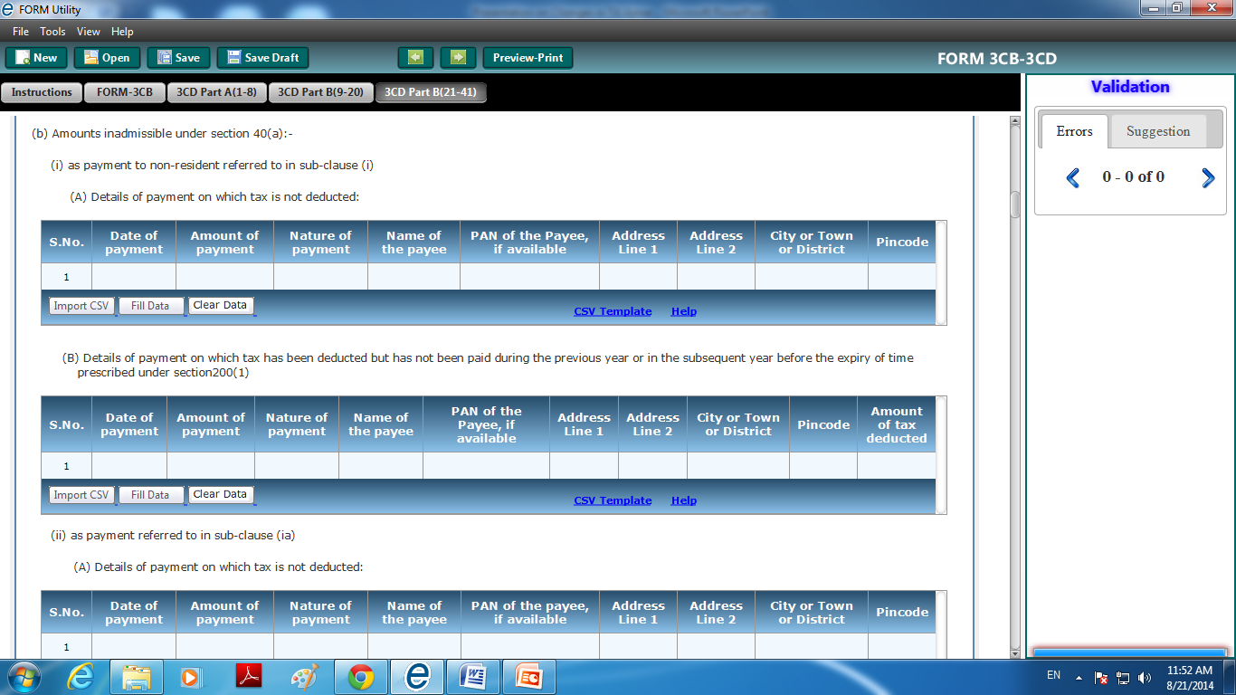

Slide 101
Clause 21(d): 40A(3)
Disallowance/deemed income under section 40A(3)
Electricity Payment to MPEB Companies
Padigela Rajeshwar Ginning Industries ITA 1137/Hyd/2011,
Trivedi Corporation (ITA 2844/Ahd/2006)
M.R. Soap (P.) Ltd. 32 TTJ 505 (DELHI)
New Limit Rs.10000
S.No. | Date of payment | Nature of payment | Amount | Name and Permanent Account Number of the payee, if available

Slide 102
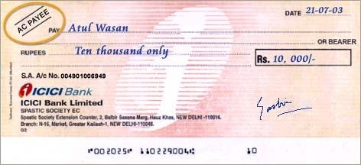
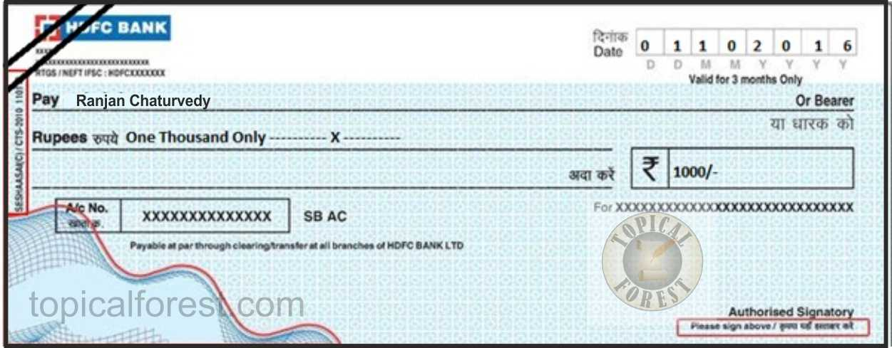

Slide 103
CROSSED CHEQUE vs. A/C PAYEE CHEQUE
There is clear distinction between a crossed cheque and an account payee cheque as in account payee cheque banks are directed to credit amount of an account payee cheque only in account of payee and no other person while crossed cheques are endorsed in favour of a person other than drawee making it difficult to trace constituent of money and thus, crossed cheque is violative of section 40A(3) - Rajmoti Industries v. Asstt. CIT [2014] 45 taxmann.com 72/223 Taxman 428 (Guj.)

Slide 104
Clause 21(b)(i):TDS Disallowances
Reporting Disallowance for
Non deduction of TDS
Non deposit of TDS deducted
Second Proviso to Section 40(a)(ia)
If the Payee has offered the same to tax
Certificate of CA in form 26A
No disallowance
Conservative view to be adopted from Audit point of view
Notes:
MP High Court in case of Jawahrlal Agrawal has held that Proviso to Section 40(a)(ia) is retrospective. Similar amendment has been brought in Finance Act 2014. Such amendment also being curative and remedial should also be retrospective as per this jurisdictional High Court decision.

Slide 105
Cl 21(i) – Disallowance u/s 36(1)(iii)
Borrowed as well as Own funds
Interest paid on borrowed funds
Interest free Loan given to sister Concerns
Whether disallowance is warranted u/s 36(1)(iii)
Reliance Utilities (Bom)
S.A. Builders 288 ITR 1 (SC)

Slide 106
Clause 23 : Related Party
Statutory audit v. TAR (MR)
Domestic Transfer Pricing repealed in non tax arbitrage
Steep Salary increase to Directors / related party
To reduce DDT and 2(22)(e) liability
Interest @ 18%
Pr CIT v Cama Hotels Ltd - [2016] 68 taxmann.com 153 (Gujarat)
Balkishan Jagannath Goyal (Indore ITAT)
Refer Notes to Accounts for Related party disclosure

Slide 107
Cl. 25: Amount chargeable u/s 41
Refers to remission or cessation of liability or bad debts for which allowance or deduction has been claimed in an earlier year
Creditors are outstanding for more than 3 years (beyond Limitation period) and no confirmation is available. Whether reporting required?
    Accept representation from Management that they are payable
    Silver Cotton Mills Co Ltd (254 ITR 728)(Guj.)
    Bhogilal Raji Atara (Guj)
Eg. Bad Debts Recovered, Write back of Provisions to be reported here

Slide 108
Clause 29: Section 56(2)(viib)
Assessee Company has issued shares to Resident
Public are not substantially interested in such Company
Issue price is higher than FMV
Report Excess from FMV received after following checks:
Obtain Management Representation
Insist for DCF Valuation Report from a CA
S.No. | Name of the person from whom consideration received for issue of shares | PAN of the person, if available | No. of Shares issued | Amount of consideration received | Fair Market value of the shares

Slide 109
Quoting of PAN
Rule 114B of I.T. Rules
Sale or purchase, by any person, of goods or services
More than 2 Lakhs per transaction

Slide 110
Brand CA - class apart
Supreme Court in case of T.D. Venkat Rao v. UOI (237 ITR 315) has upheld the superiority of CAs by noting that
Chartered Accountants, by reason of their training have special aptitude in the matter of audits and no other person can be held eligible to conduct audit under Section 44AB. Supreme Court further held that CAs are a Class by themselves meaning that CAs are the brand for auditing itself.

Slide 111
Thank You
Start Auditing……
CA Pankaj G. Shah
G.J. Shah & Company
Chartered Accountants
Mobile 9691893040
E-mail: pankajgshah@gmail.com

